Slide 1
Development of New Capabilities and Enhancements to the USACE Two-Dimensional Reservoir Water Quality Model (CE-QUAL-W2)
PDT Lead: Todd Steissberg (ERDC)
Product Development Team:
Billy Johnson (ERDC)
Zhonglong Zhang (PSU)
Scott Wells (PSU)
Chris Berger (PSU)
John Kucharski (ERDC)
Kervi Ramos (ERDC)
Barry Bunch (ERDC)
Corps District Collaboration:
Brian Zettle (Mobile District, CoP Lead)
Kathryn Tackley (Portland District)
Dan Turner (Northwest Division)
J. J. Baum (Sacramento District)
Laurel Hamilton (Omaha District)
Jim Noren (St. Paul District)

Slide 2
Project Purpose - Recap
This work unit was developed in response to SON ENV 1174, “Development of New Capabilities and Enhancements to the USACE Two-Dimensional Reservoir Water Quality Model (CE-QUAL-W2),” presented to the 2018 ERARG and to address SON ENV 1550, “Two-Dimensional Water Quality Capabilities for Reservoir Operations Decision-Making,” presented to the 2020 ERARG.
Objectives:
Upgrade CE-QUAL-W2 to incorporate the latest water quality modeling R&D at ERDC
Restructure current CE-QUAL-W2 model source code to use robust data storage file formats that adhere to widely-supported modern standards, e.g., HDF5 and JSON, enabling seamless linkage with other models, e.g., HEC-RAS and HEC-ResSim, improving multi-model system reliability and reducing maintenance cost of software, models, and linked modeling systems.
Notes:
Keep it simple and clear. You may use a second slide if needed, however.

Slide 3
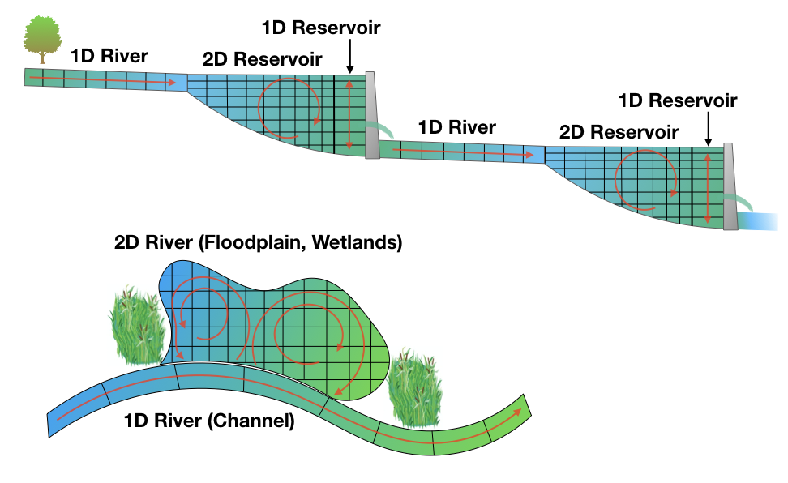
Project Purpose - Recap
Objectives, continued:
Decouple the WQ component from hydrodynamics in the current version of CE-QUAL-W2, allowing water quality simulations to run multiple times with the same hydrodynamic results, eliminating costly repeated hydrodynamic computations
Update the technical reference manual and user’s manual
Release comprehensive version of CE-QUAL-W2, reviewed by ERDC experts
Notes:
Keep it simple and clear. You may use a second slide if needed, however.

Slide 4
Benefits
The updated CE-QUAL-W2 model will support the Corps’ high priority need for environmental assessment, restoration, and management.
Incorporation of reservoir operations capabilities will enable water quality and other environmental objectives to influence reservoir release decisions, improving model accuracy and delivering high quality multi-objective decision-making to achieve ecosystem benefits.
Critical downstream habitat will be better managed for water quantity (volume, velocity, depths, etc.) in addition to water quality (water temperature, dissolved oxygen, total dissolved gas, etc.).
Linkage of WQ with multi-objective decision analysis increases project benefits while decreasing modeling and project costs.
Development of improved and accessible reservoir water quality modeling capabilities will reduce time and cost associated with upgrading water quality models and adding new model capabilities.
The new file formats improve model robustness and facilitate linking W2 models with other models.
Notes:
Keep it simple and clear. You may use a second slide if needed, however.

Slide 5
Approach
Task 1: Upgrade Water Quality Kinetics
Incorporate new capabilities developed at ERDC-EL into the current CE-QUAL-W2 model maintained by PSU
Develop full carbon cycle with nitrogen and phosphorous cycles and integrate into previous version of W2 at ERDC
Reformulate simulations of BOD groups (CBOD, NBOD, and PBOD) included in current version of W2 to ensure appropriate simulation of these constituents
Develop sediment diagenesis module, include into the previous version, and merge into updated version for further testing and validation
Incorporate final sediment diagenesis module into release version
Notes:
Keep it simple and clear. Particularly with modeling efforts - the interaction of different models, modules and updates needs to be clear. Where in the grand scheme of things does this research fit?

Slide 6
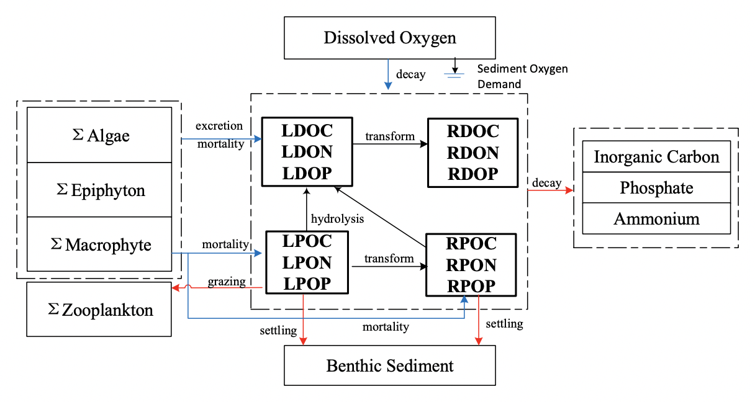
Approach
Task 1 Figure

Slide 7
Approach
Task 2: Upgrade W2 Model Input and Output
Restructure code in order to change storage formats, thereby enabling seamless linkage with other models
Transition to a modern format, such as HDF5 and JSON, to create a reliable, robust storage system that can be easily validated
Leverage existing software to allow harvesting into data catalog systems designed to service a broad range of users, enabling non-expert users to visualize model outputs, map model results, and compare with field data and with other models
Consolidate input datasets into a single file system, allowing users to easily examine input parameters and boundary conditions
Develop a utility to import previous W2 model inputs into the new data storage formats for the updated version
Notes:
Keep it simple and clear. Particularly with modeling efforts - the interaction of different models, modules and updates needs to be clear. Where in the grand scheme of things does this research fit?

Slide 8
Approach
Task 3: Create Python/Jupyter Model Framework
Develop a framework, using Python, to link CE-QUAL-W2 with modern scientific Python libraries, enabling development of new input/output and plotting analysis capabilities
Develop plotting capabilities to visualize project bathymetry files, water quality and hydrodynamic time series, and 2D contour plots of reservoir water quality profiles
Develop a prototype Jupyter notebook to link the capabilities together, to create a powerful and flexible self-documented user interface (UI) that is relatively simple to develop
Update and extend this new interface throughout completion of subsequent tasks
Notes:
Keep it simple and clear. Particularly with modeling efforts - the interaction of different models, modules and updates needs to be clear. Where in the grand scheme of things does this research fit?

Slide 9
Approach
Task 4: Develop Reservoir Operations Capabilities
Enable W2 to incorporate water quality and other environmental objectives into reservoir releases calculations, while balancing these with flood control, hydropower, navigation, water supply, and navigation objectives
Incorporate capability into W2 to examine dam flow control impacts on downstream water quality and determine how downstream temperature and water quality objectives will be met
Create capabilities in W2 to examine impacts of dams and flow regulation on downstream temperature and water quality conditions while identifying how operations may be improved to maximize ecosystem benefits
Notes:
Keep it simple and clear. Particularly with modeling efforts - the interaction of different models, modules and updates needs to be clear. Where in the grand scheme of things does this research fit?

Slide 10
Approach
Task 5: Upgrade Hydrodynamic & Water Quality Computation Engine
Decouple water quality component from hydrodynamics in W2 in cases where the water quality state variable does not impact hydrodynamics, thereby increasing computational efficiency
Run hydrodynamic simulations for a prescribed period, store output, and use data as input for multiple water quality simulations
Implement a simultaneous equation solution of the water surface in all branches for the updated model, enhancing hydrodynamic stability of riverine segments
Support increasing demand to include water quality operating objectives for water management by updating selective withdrawal algorithm to account for overlapping withdrawal zones for multiple outlets (versus simply adding them together)
Evaluate using multi-core processing capability with numerical precision of simulations vs. fast code execution
Notes:
Keep it simple and clear. Particularly with modeling efforts - the interaction of different models, modules and updates needs to be clear. Where in the grand scheme of things does this research fit?

Slide 11
Approach
Task 6- CE-QUAL-W2 v5.0 final version with documentation
Prepare and post final release version of CE-QUAL-W2 Version 5.0 to the ERDC website for release
Conduct a case study demonstrating all capabilities included in the final release version of CE-QUAL-W2 and document in a technical note
Post updated CE-QUAL-W2 Technical Reference Manual and User’s Manual to ERDC’s web site
Prepare a final webinar using the case study and present to USACE District and Division staff, including water quality modelers and managers
Notes:
Keep it simple and clear. Particularly with modeling efforts - the interaction of different models, modules and updates needs to be clear. Where in the grand scheme of things does this research fit?

Slide 12
Field Engagement
Project Planning
Team meetings & conference calls
Periodic project updates to PDT, ERARG members, and field personnel by phone, web meeting, and email
Reporting
Provided quarterly updates to the USACE Water Quality Committee
Field Work Coordination
Coordination with NWD (Kathryn Tackley, Dan Turner, Alexis Mills, and Norm Buccola)

Slide 13
Scheduled Products¹
Scheduled Products
Description | Scheduled Due Date | Current Percent Complete | Projected Completion Date
 | (Qtr/Yr) | (%) | (Qtr/Yr)
1. CE-QUAL-W2 Version 4.3 | Q2/FY21 | 0 | Q2/FY21
2. CE-QUAL-W2 Version 5.0 Alpha | Q2/FY22 | 0 | Q2/FY22
3a. Python Framework 3b. Prototype Jupyter Notebook 3c. Plotting Capability | Q1/FY21 Q1/FY21 Q1/FY21 | 75 75 75 | Q1/FY21 Q1/FY21 Q1/FY21
4. CE-QUAL-W2 Operations Capability | Q4/FY21 | 0 | Q4/FY21
¹ As per work unit documentation
Notes:
Include all PRODUCTS/DELIVERABLES as specified in the original WU documentation

Slide 14
Scheduled Products¹
Scheduled Products
Description | Scheduled Due Date | Current Percent Complete | Projected Completion Date
 | (Qtr/Yr) | (%) | (Qtr/Yr)
5. CE-QUAL-W2 Version 5.0 Beta | Q2/FY23 | 0 | Q2/FY23
6a. CE-QUAL-W2 Version 5.0 Final 6b. User's Manual 6c. Technical Reference Manual 6d. Webinar 6e. Technical Note | Q4/FY23 Q4/FY23 Q4/FY23 Q4/FY23 Q4/FY23 | 0 0 0 0 0 | Q4/FY23 Q4/FY23 Q4/FY23 Q4/FY23 Q4/FY23
¹ As per work unit documentation
Notes:
Include all PRODUCTS/DELIVERABLES as specified in the original WU documentation

Slide 15
Additional Products/Achievements
Additional Products/Achievements
Description | (Qtr/Yr)
1. Recruited and hired two team members at EL-EPW with excellent software development skills (Kervi Ramos and John Kucharski) 2. Recruited computer scientist at EL-EPW, to be hired in Q1/FY21 | Q3/FY20 Q1/FY21

Slide 16
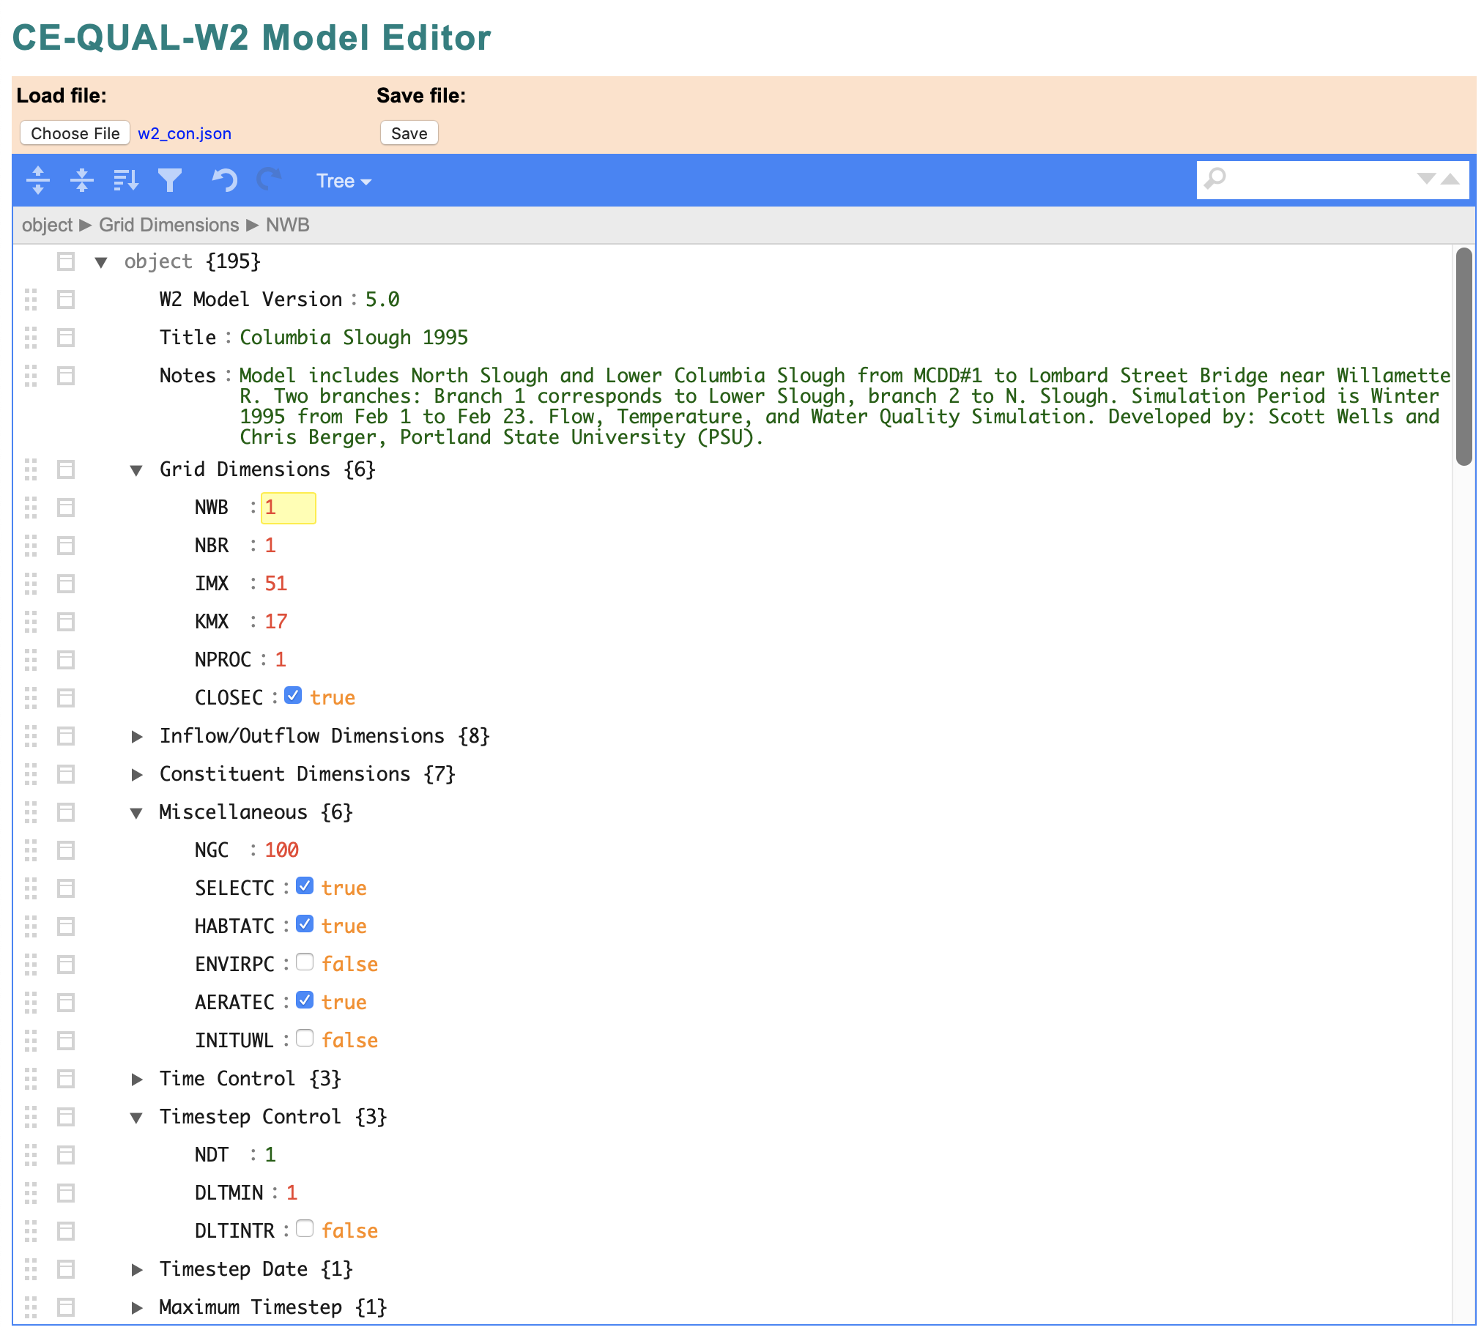
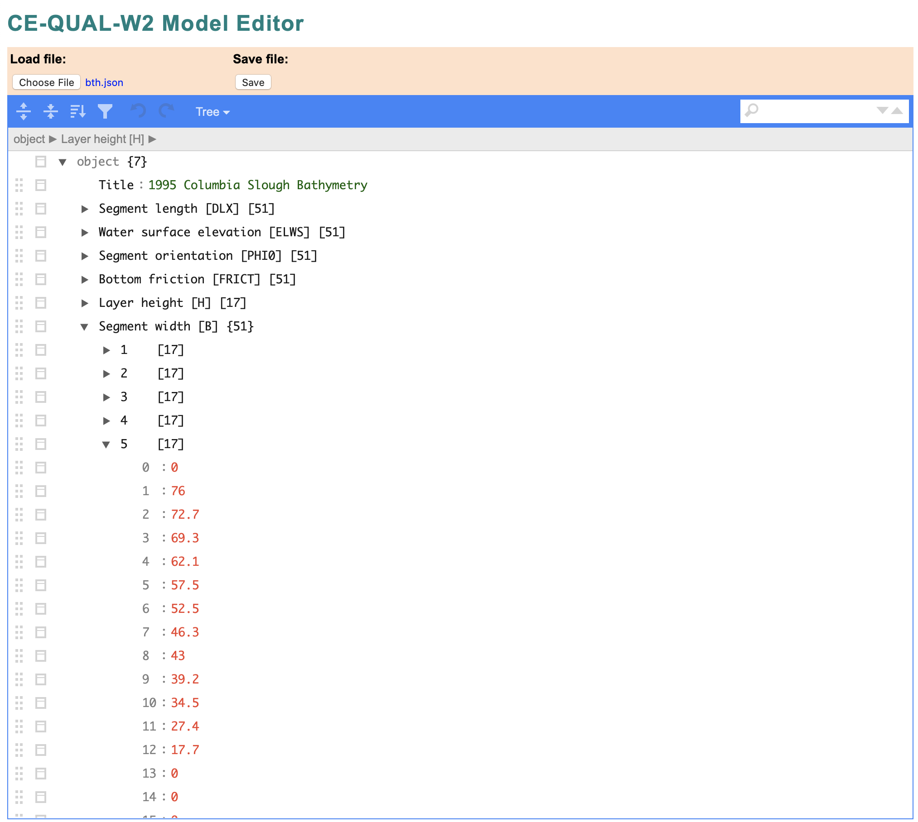
FY 20 Accomplishment 1
Description: Developed prototype input and output specification. Developed user interface that reads and writes the new JSON-formatted control and bathymetry files.
Status: On time
Notes:
Describe product and capability, importance/impact, etc.. Employ images generously. Tell a good story.

Slide 17
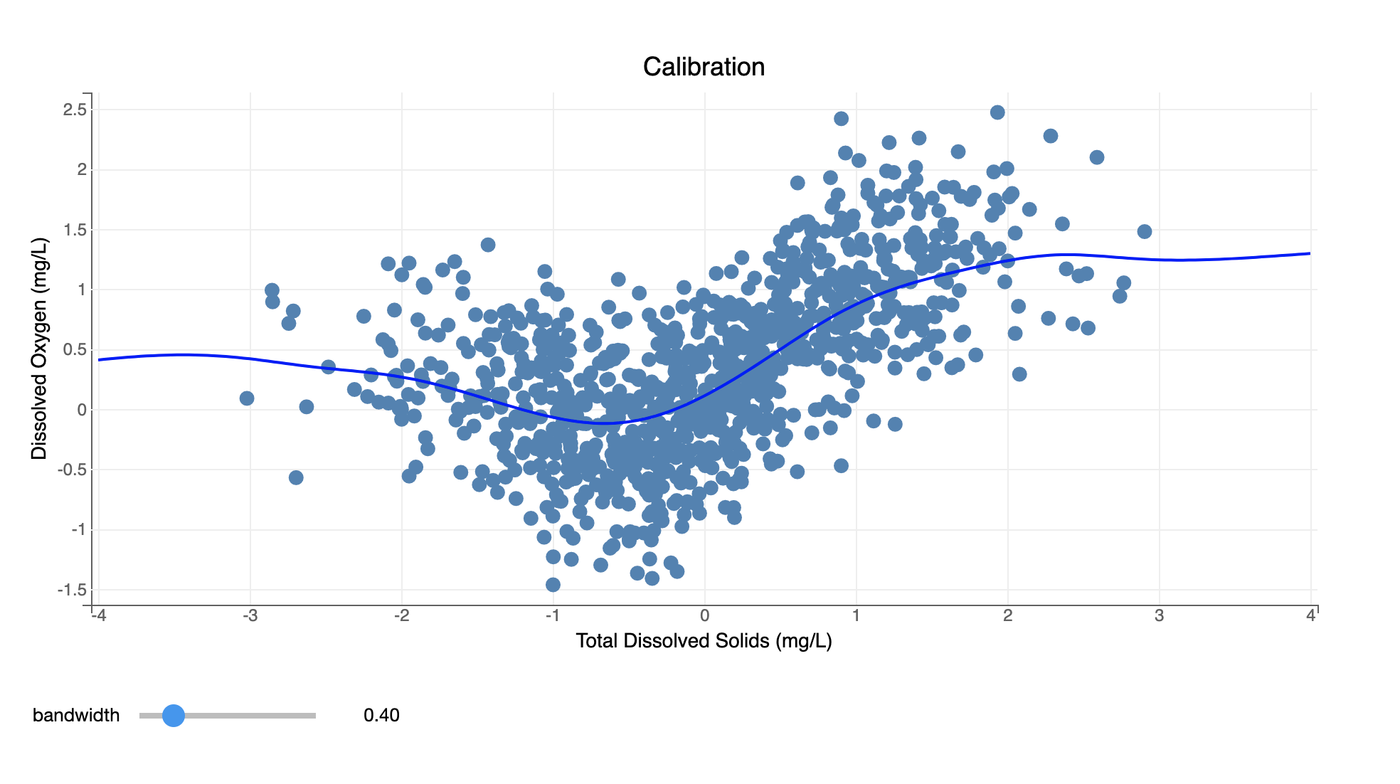
FY 20 Accomplishment 2
Description: Developed prototype framework, Jupyter UI, & WQ plotting tools
Status: On time
Notes:
Describe product and capability, importance/impact, etc.. Employ images generously. Tell a good story.

Slide 18
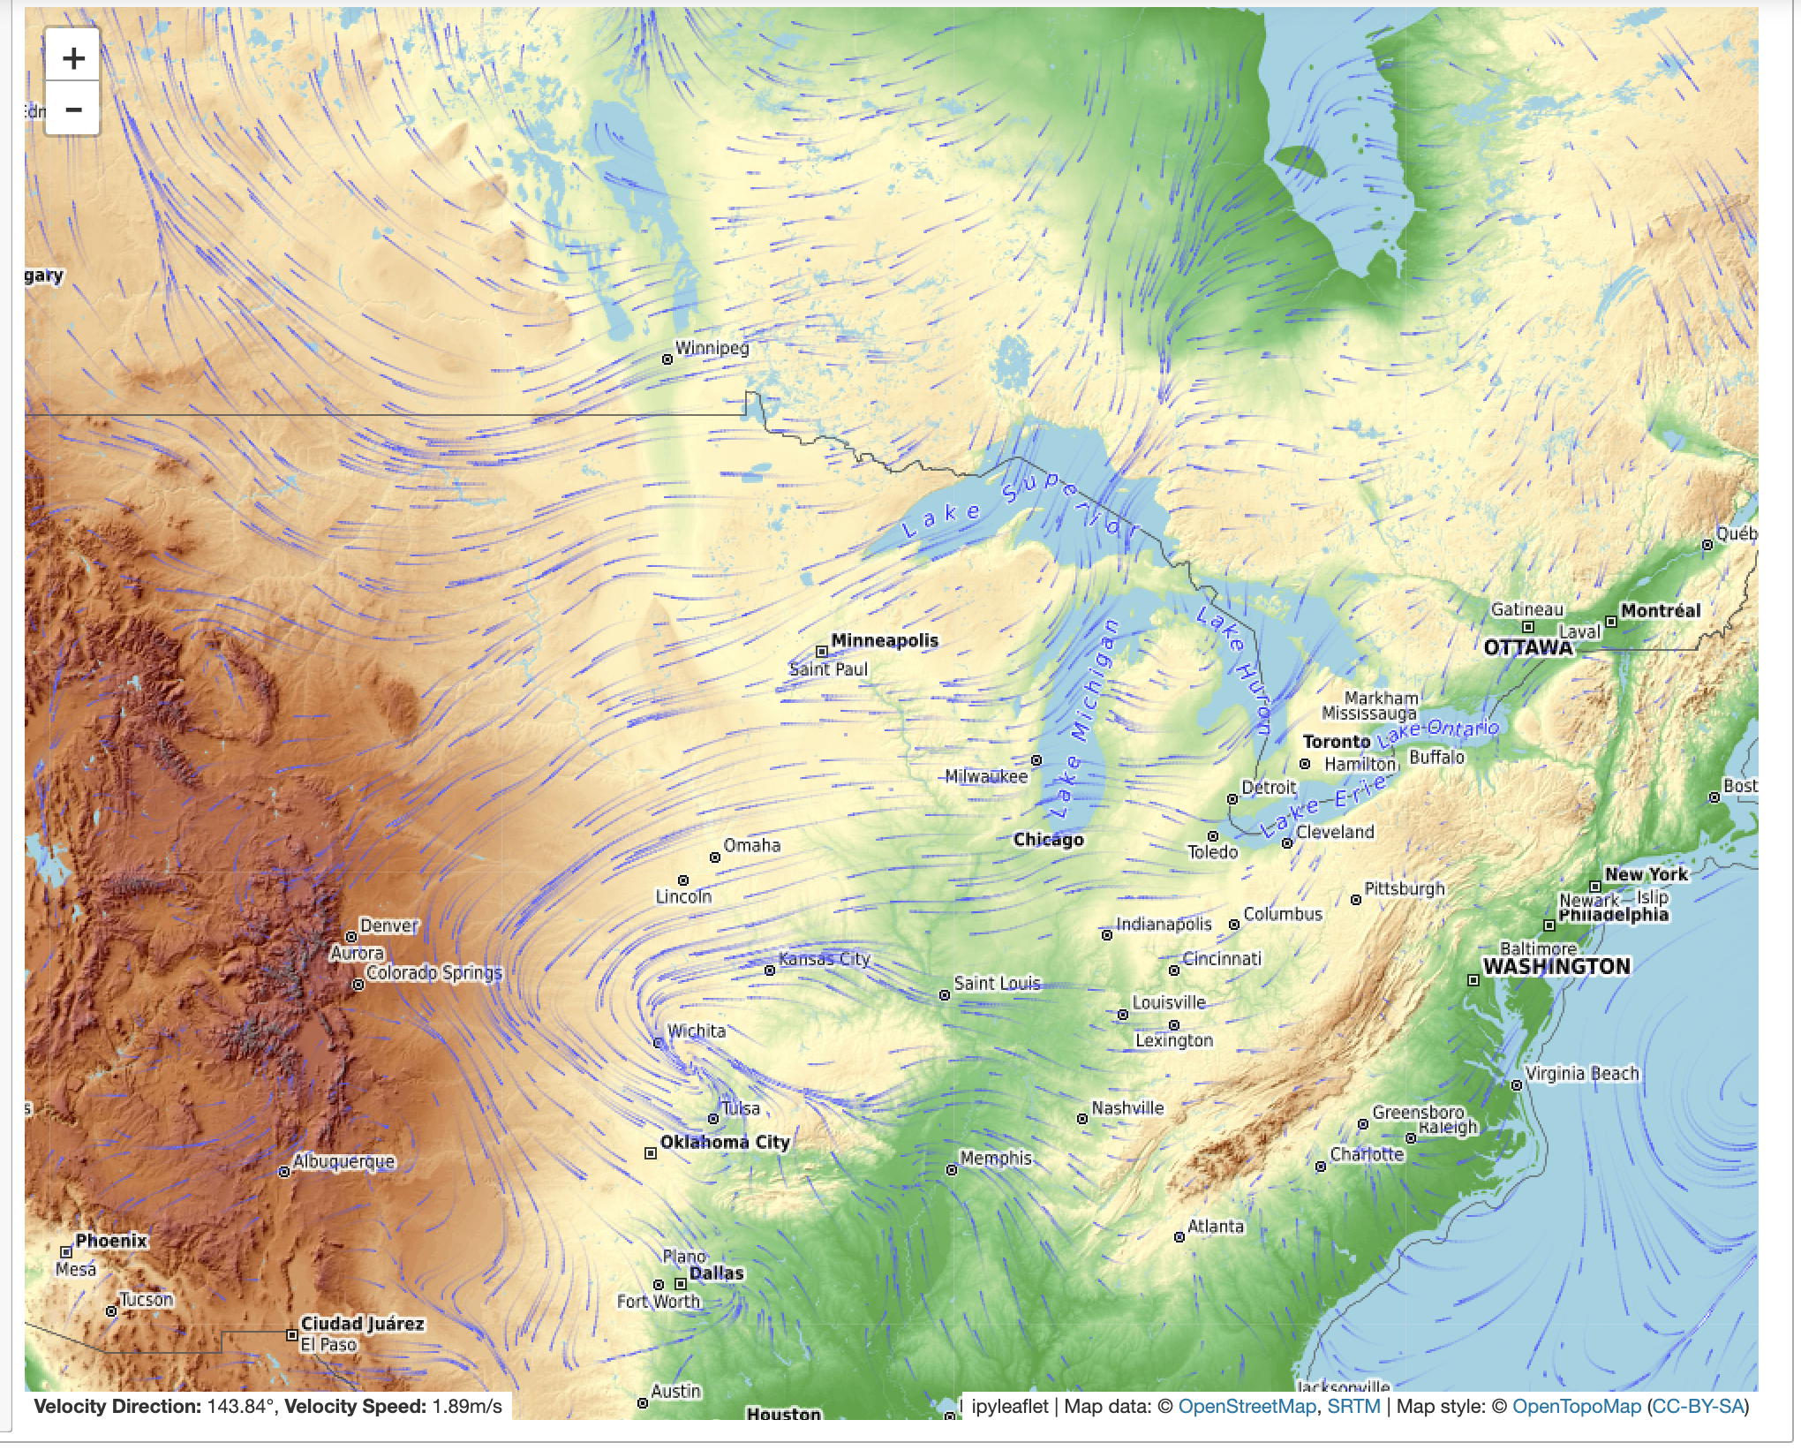
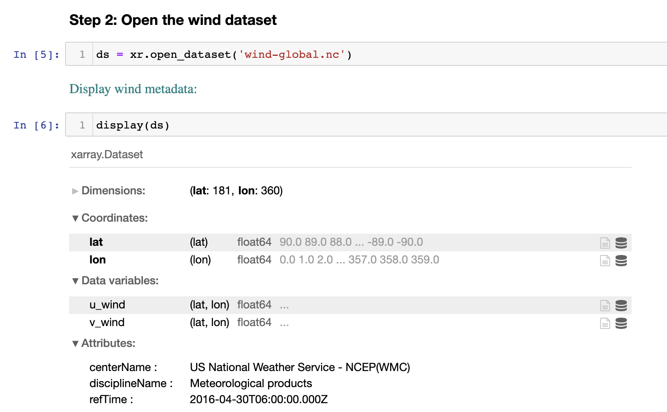
FY 20 Accomplishment 2
Description: Developed prototype framework, Jupyter UI, & WQ plotting tools
Status: On time
Notes:
Describe product and capability, importance/impact, etc.. Employ images generously. Tell a good story.

Slide 19
Synopsis
Funding
FY20 $250K
FY21 $385K
FY22 $375K
FY23 $290K
Project $1300K
Project status
On schedule
Project focus
On target
Other comments
CESU awarded to Portland State University (PSU) with funding for FY21 development
LimnoTech R&D IDIQ awarded with task order for WQ model development
Notes:
Funding for all FY’s funded

Slide 20
Summary
Designed input and output file specification
Developed prototype framework in Python
Implemented JSON specification for control and bathymetry
Developed a JavaScript user interface (UI) for the control and bathymetry input files
Developed prototype time series plotting library

